Slide 1

ARULMIGU PALANIANDVAR COLLEGE OF ARTS AND CULTURE
DEPARTMENT OF MATHEMATICS
Course name: Data Literacy with tableau
Project name: The tableau HR scorecard Measuring Success in Talent Management.
Team member:
A.Selvaharish
M.Sabari
R.Sivaprakesh
S.sivakumar
MENTOR
K. MARUTHAMUTHU

Slide 2
INTRODUCTION TO TABLEAU
Tableau desktop is a data visualization application to facilitate you to examine virtually any kind of structured data and generate highly interactive , beautiful graphs, dashboards, and reports within minutes.
Once a quick installation, you can tie to virtually any data source from spreadsheets to data warehouses and display information in several graphic perspectives.
Designed to be easy to utilize, you’ll be working more rapidly than ever before.

Slide 3
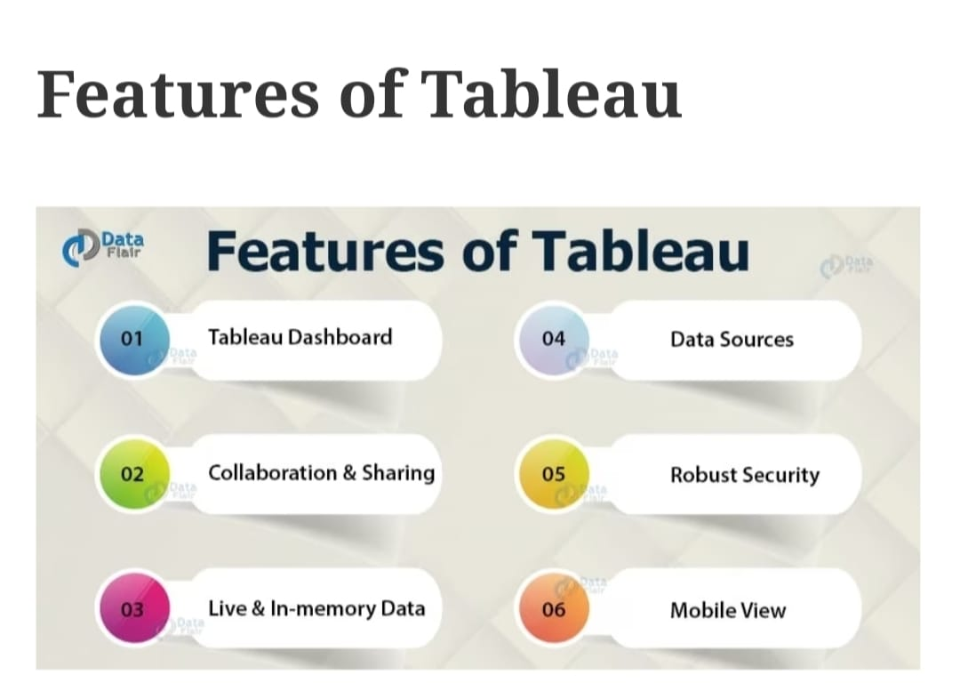
KEY FEATURES OF TABLEAU

Slide 4
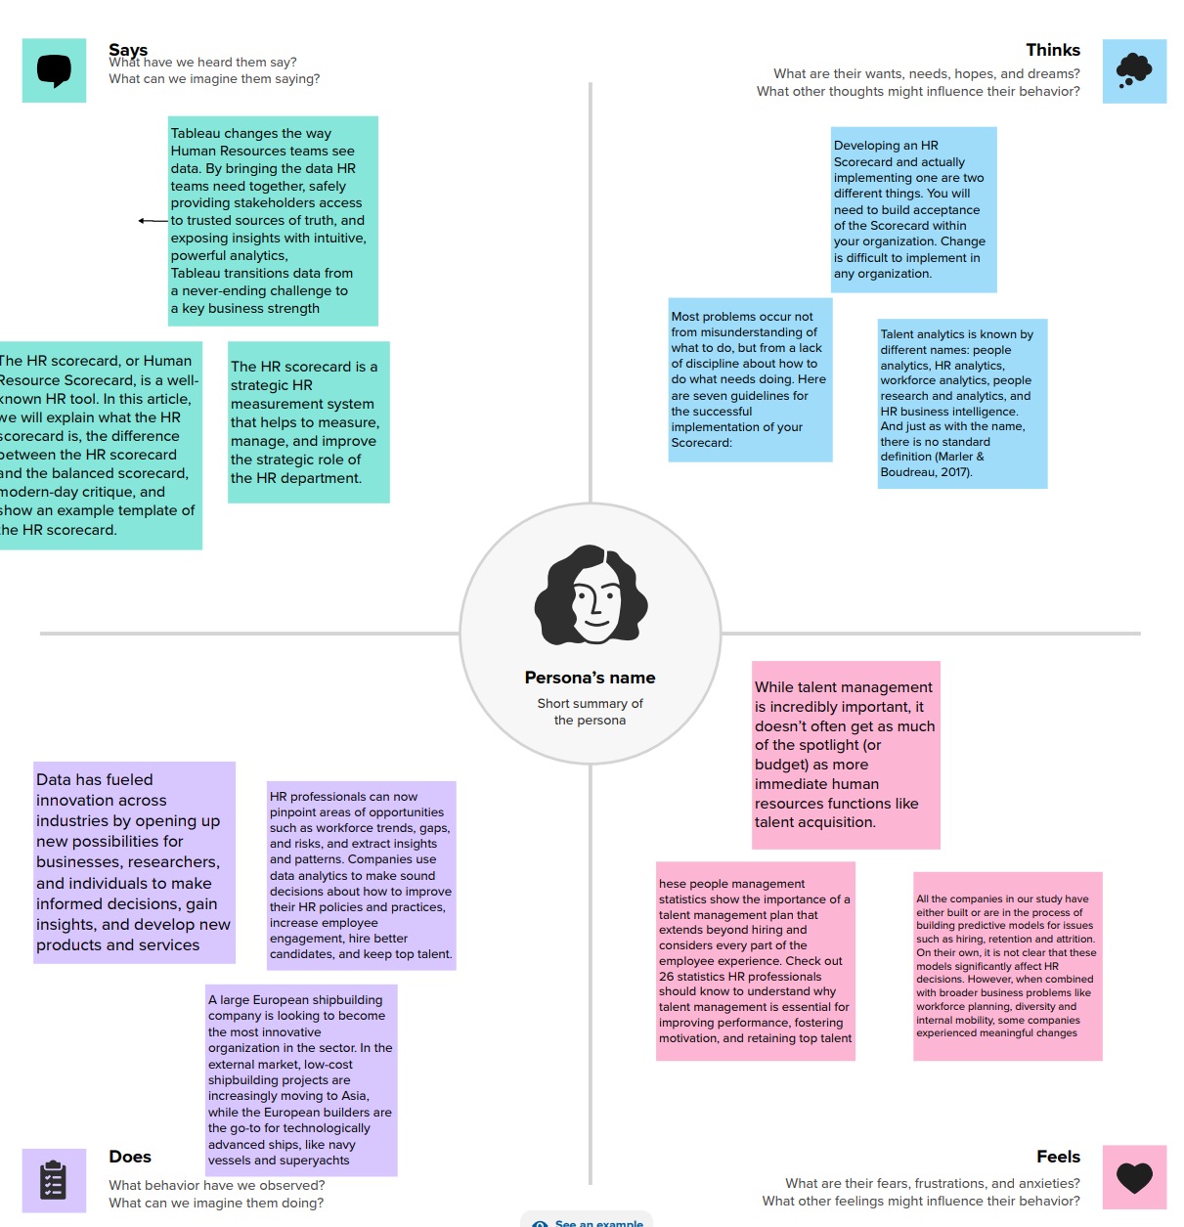
EMPATHY MAP

Slide 5
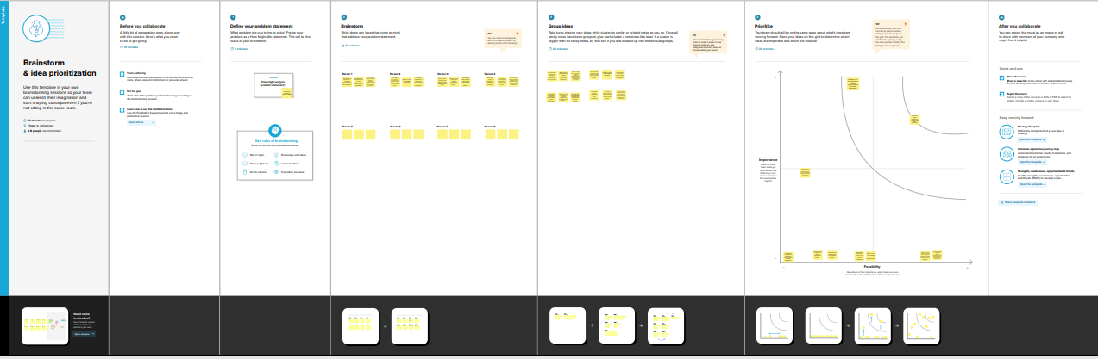
BRAINSTORMING MAP

Slide 6
DATA SET

Slide 7
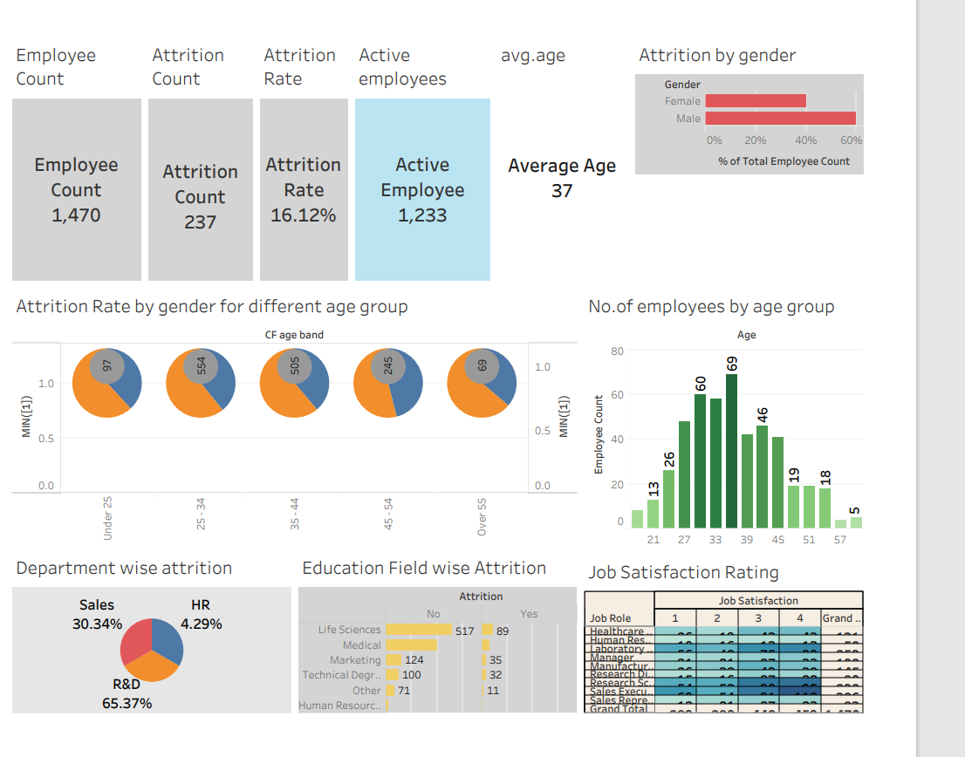
DASHBOARD

Slide 8
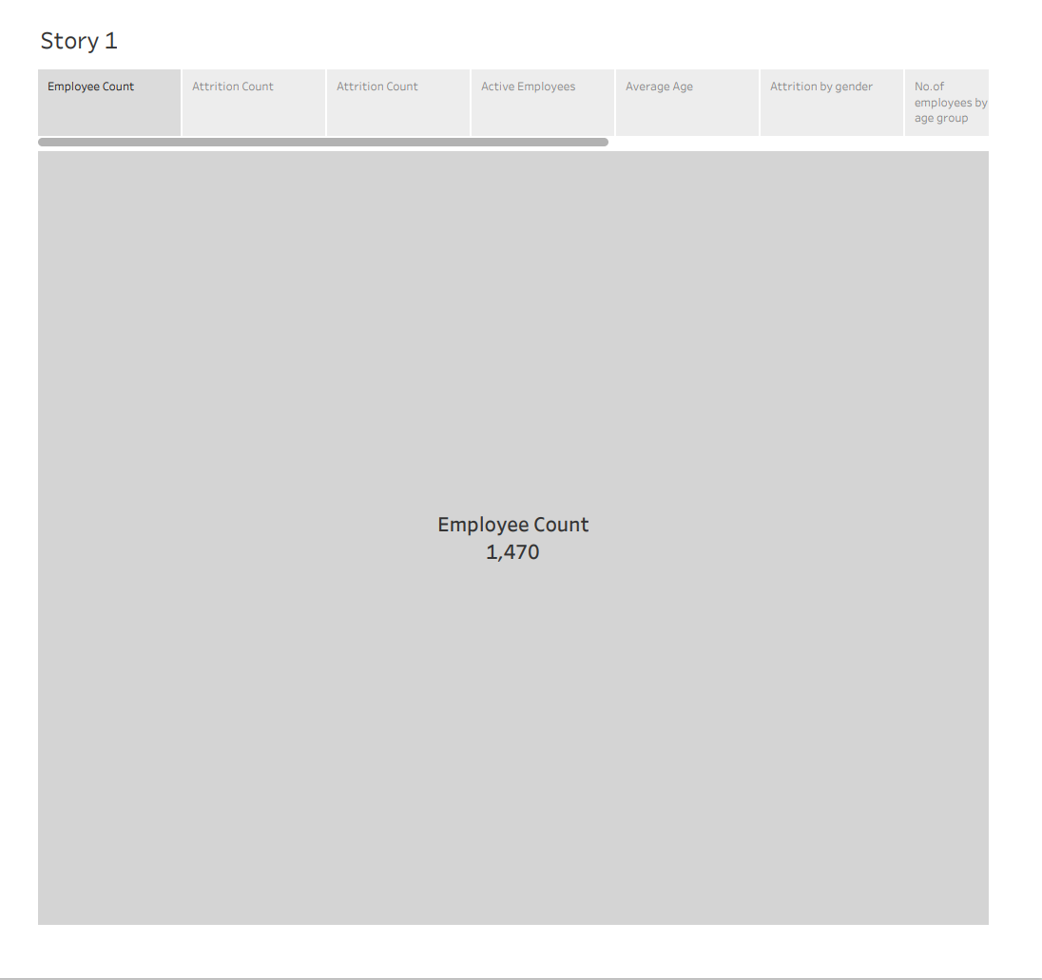
STORY

Slide 9
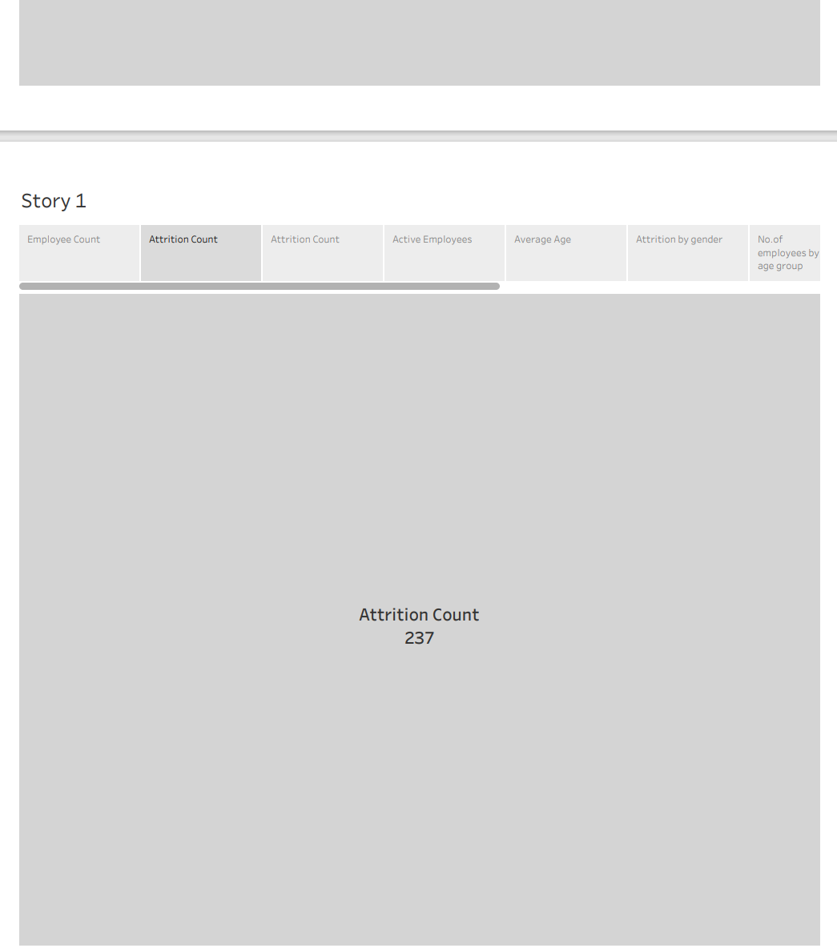

Slide 10
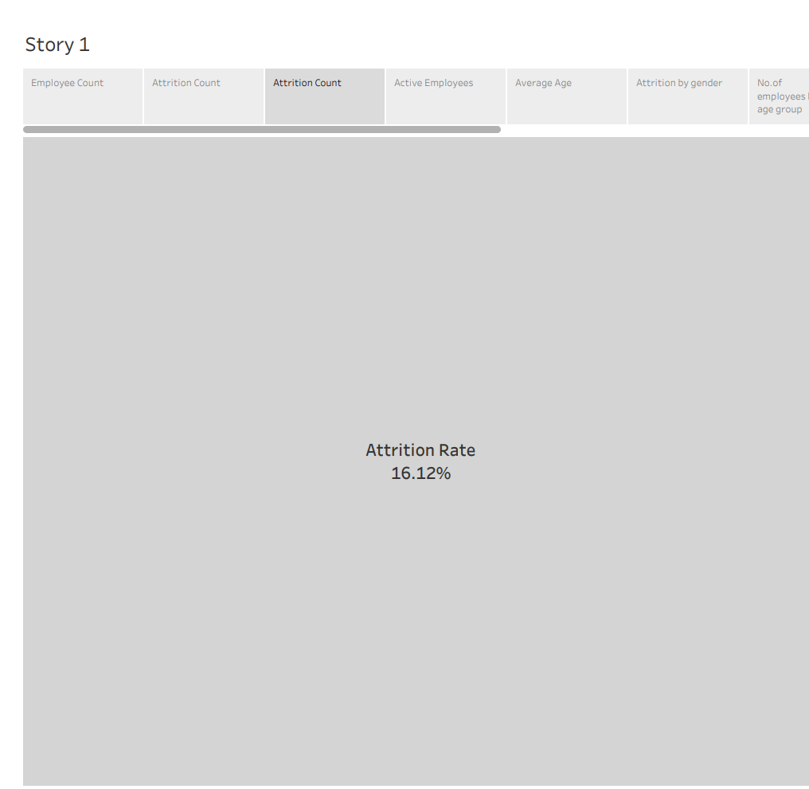

Slide 11
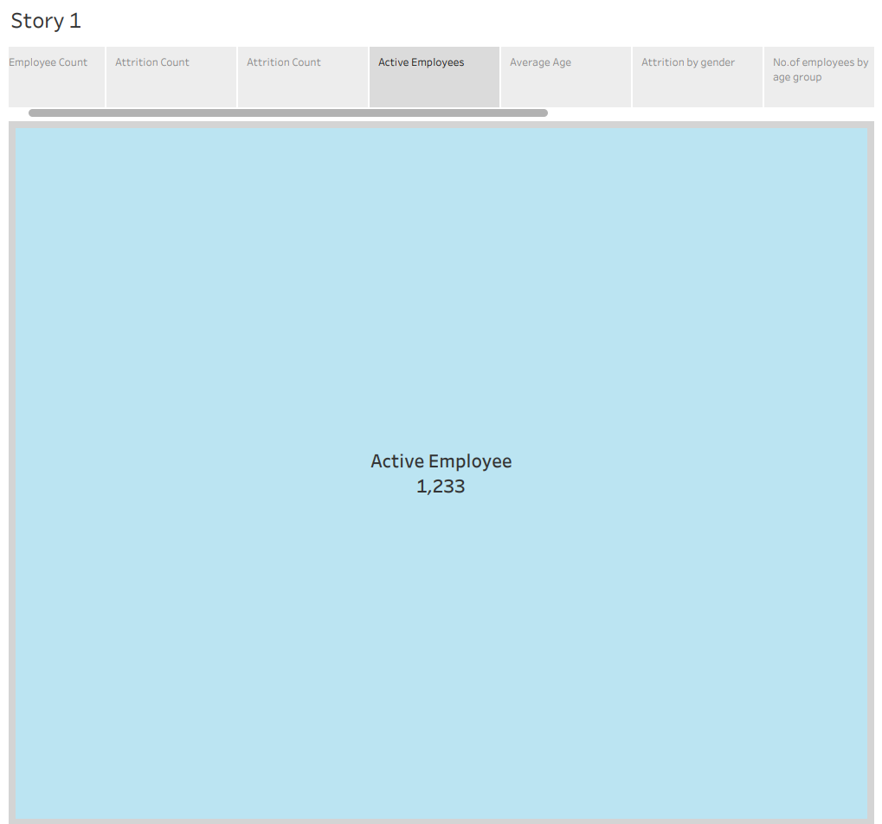

Slide 12
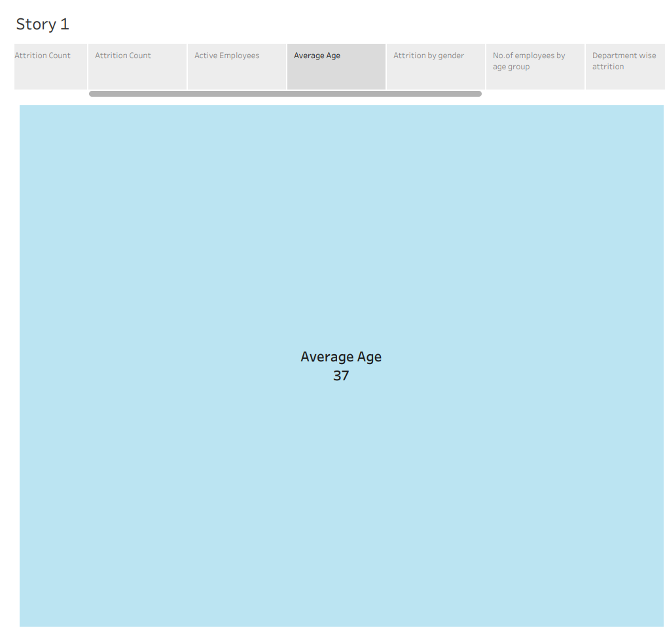

Slide 13
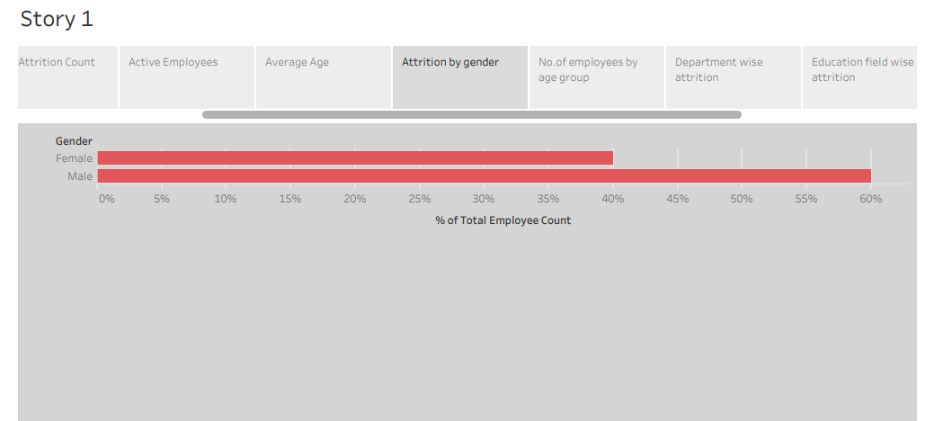

Slide 14
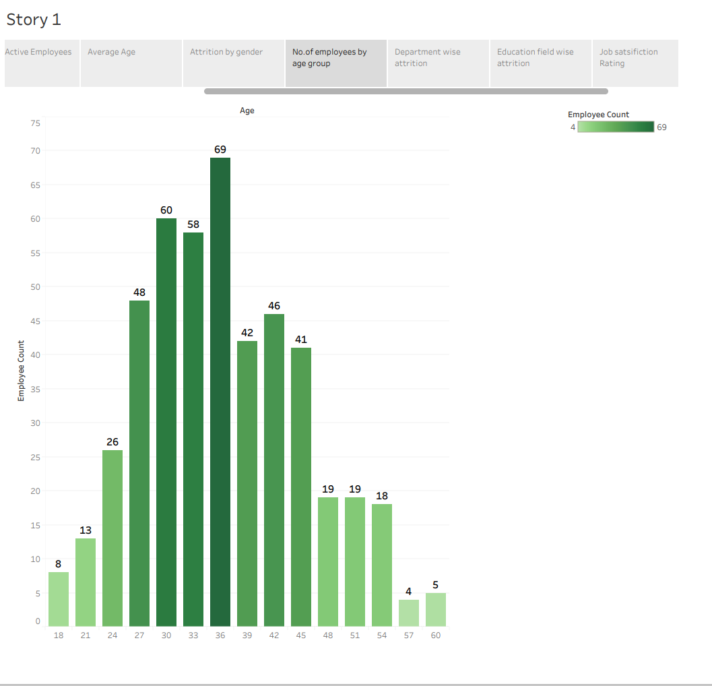

Slide 15
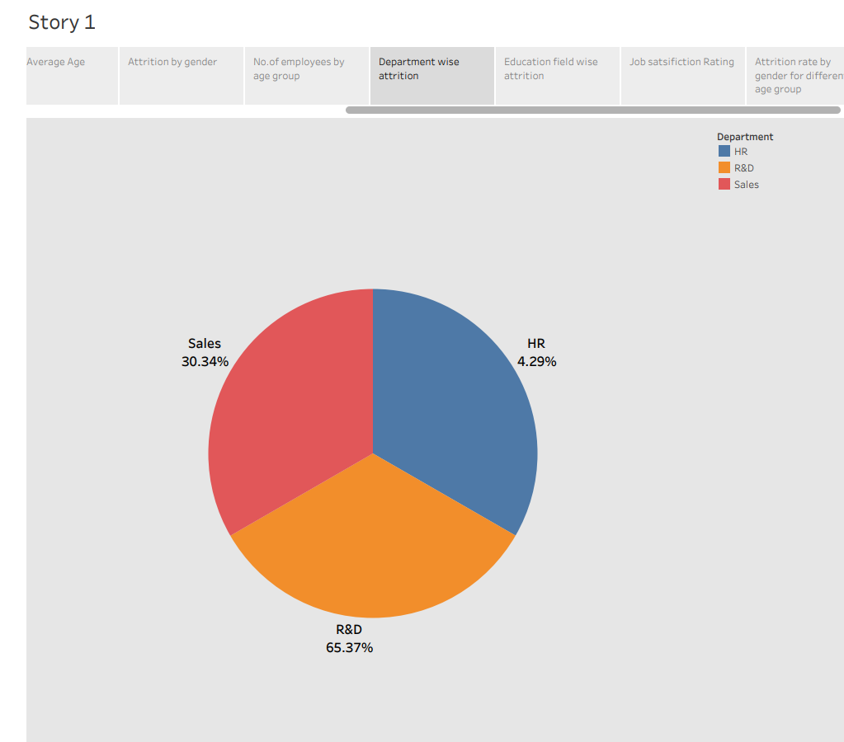

Slide 16
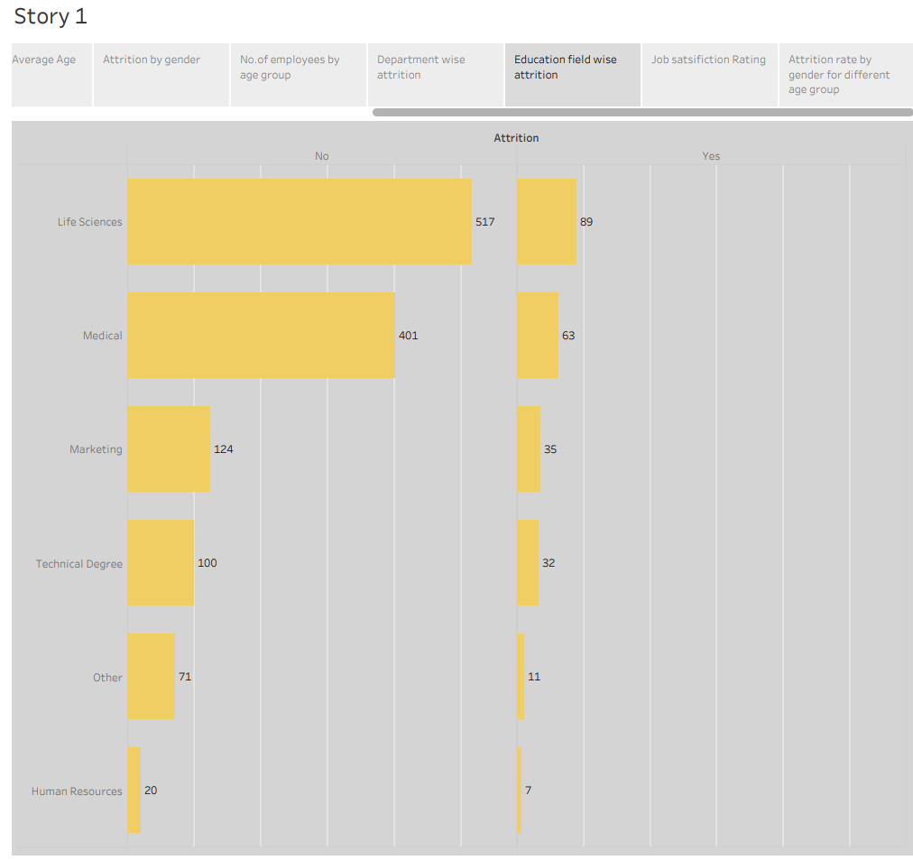

Slide 17
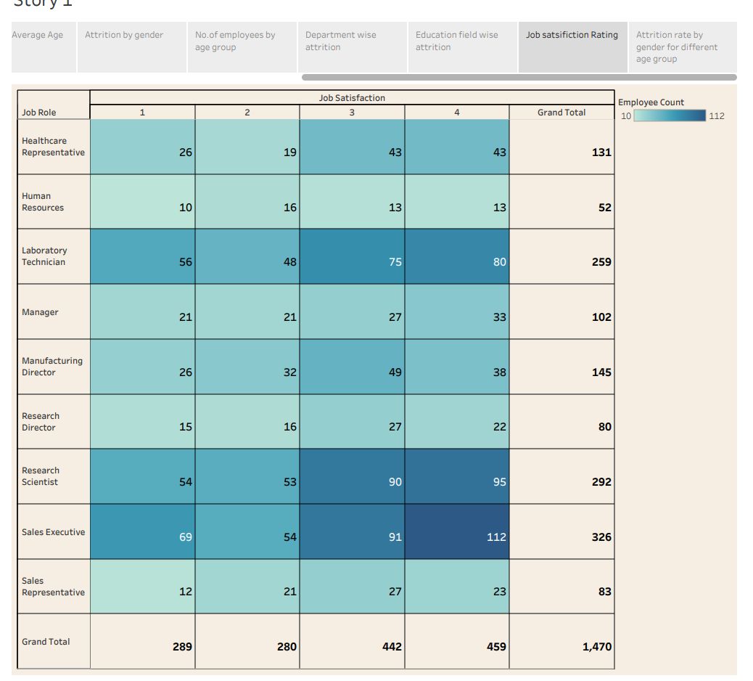

Slide 18
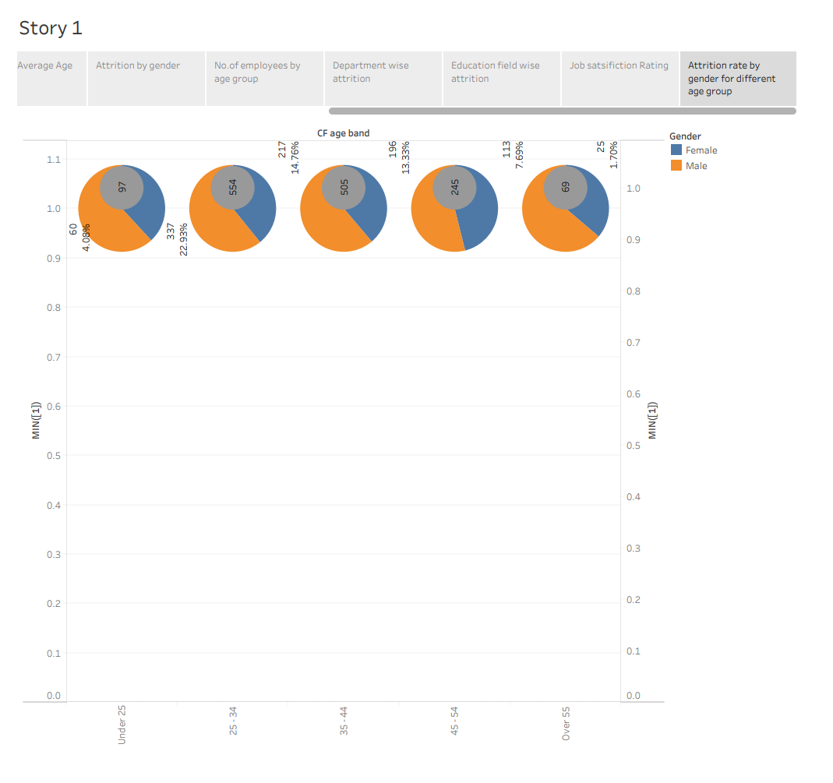

Slide 19
TABLEAU PUBLIC LINK
https://public.tableau.com/app/profile/selva.harish/viz/dashboard_16965909141680/HRANALYTICSDASHBOARD?publish=yes
https://public.tableau.com/app/profile/selva.harish/viz/story_16965903678550/Story1?publish=yes

Slide 20
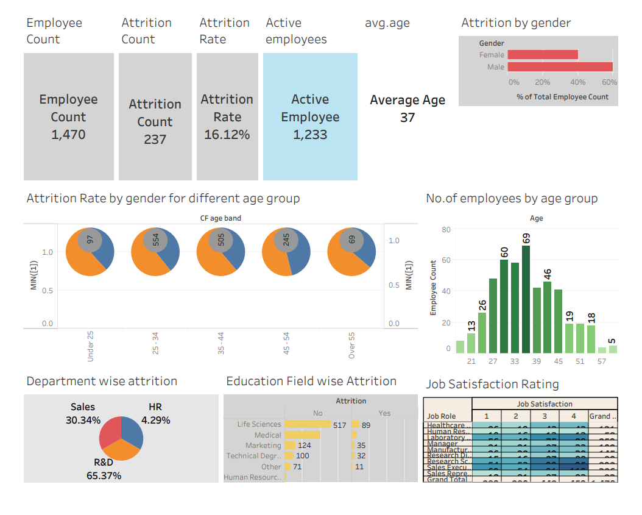
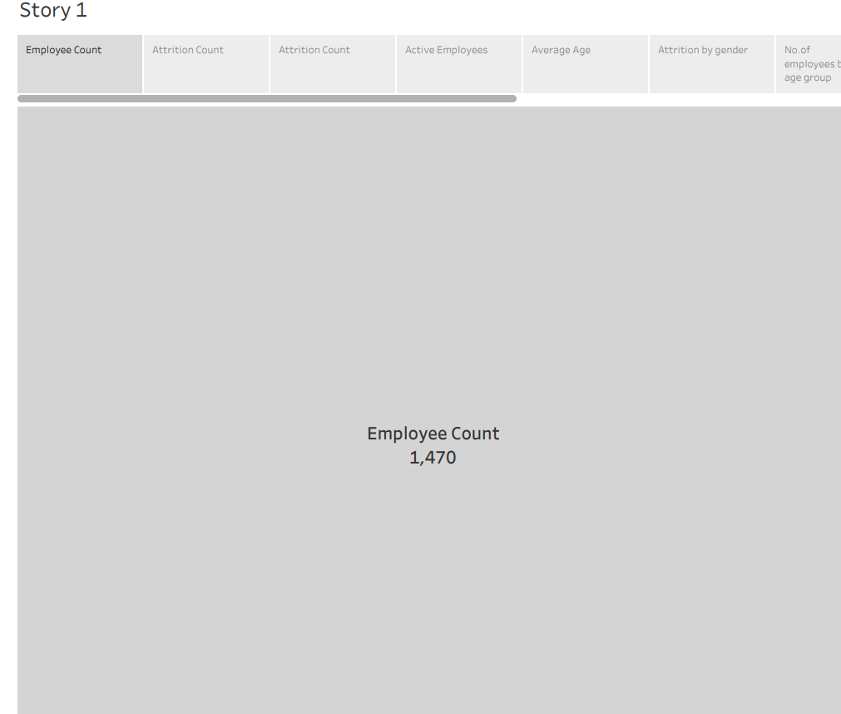
Screen shot of dashboard and story

Slide 21
CONCLUSION
Tableau is an excellent program to simplify all your data visualizations activities and provide better and more accurate analysis if you’ve ever tried data visualization and found it tough to grasp or too complex..

Slide 22
Thank you

